Slide 1


Slide 2

PROJECT HR PLANNING,
RECRUITMENT & SELECTION
Notes:
The incidence of both lower incomes due to economic crisis and persistent high food prices has proved to be a devastating combination for the world’s most vulnerable populations.

Slide 3
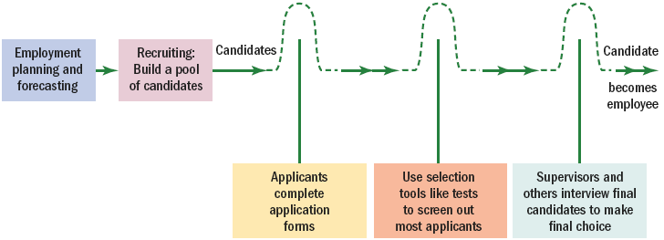
Steps in Recruitment and Selection Process
The recruitment and selection process is a series of activities aimed at selecting the best candidate for the job.

Slide 4
Recruitment and Selection Process
Decide what positions you’ll have to fill through personnel planning and forecasting.
Build a pool of candidates for these jobs by recruiting internal or external candidates.
Have candidates complete application forms and perhaps undergo an initial screening interview.
Use selection techniques like tests, background investigations, and physical exams to get the best.
Decide who to make an offer to, by having the supervisor and perhaps others on the team to interview the candidates.

Slide 5
Effective Recruiting
External factors affecting recruiting:
  Looming/imminent undersupply of workers
  Lessening of the trend in outsourcing of jobs
  Increasingly fewer “qualified” candidates
Internal factors affecting recruiting:
  The consistency of the firm’s recruitment efforts with its strategic goals
  The available resources, types of jobs to be recruited and choice of recruiting methods
  Nonrecruitment HR issues (10% more salary) and policies
  Line and staff coordination and cooperation

Slide 6
Effective Recruiting
Advantages of centralizing recruitment
  Strengthens employment brand
  Ease in applying strategic principles
  Reduces duplication of HR activiites
  Reduces the cost of new HR technologies
  Builds teams of HR experts
  Provides for better measurement of HR performance
  Allows for the sharing of applicant pools

Slide 7
Measuring Recruiting Effectiveness
What to measure and how to measure
  How many qualified applicants were attracted from each recruitment source?
    Assessing both the quantity and the quality of the applicants produced by a source.
High performance recruiting
  Applying best-practices management techniques to recruiting.
    Using a benchmarks-oriented approach to analyzing and measuring the effectiveness of recruiting efforts such as employee referrals.

Slide 8
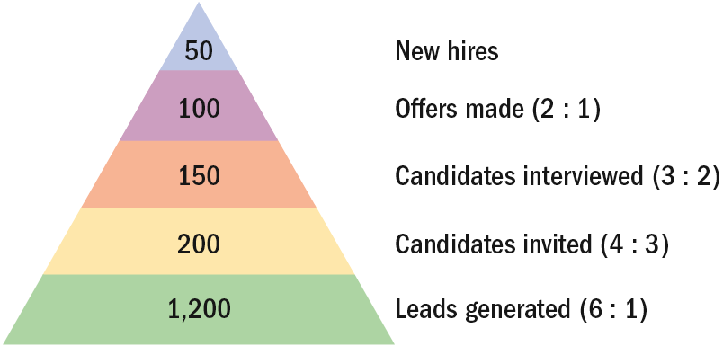
Recruiting Yield Pyramid
Recruiting yield pyramid
  The historical arithmetic relationships between recruitment leads and invitees, invitees and interviews, interviews and offers made, and offers made and offers accepted.

Slide 9
Internal Sources of Candidates
Advantages
  Foreknowledge of candidates’ strengths and weaknesses
  More accurate view of candidate’s skills
  Candidates have a stronger commitment to the company
  Increases employee morale
  Less training and orientation required
Disadvantages
  Failed applicants become discontented
  Time wasted interviewing inside candidates who will not be considered
  Inbreeding of the status quo

Slide 10
Finding Internal Candidates
Job posting
  Publicizing an open job to employees (often by literally posting it on bulletin boards) and listing its attributes/requirements and benefits.
Rehiring former employees
  Advantages:
    They are known quantities.
    They know the firm and its culture.
  Disadvantages:
    They may have less-than positive attitudes.
    Rehiring may sent the wrong message to current employees about how to get ahead.

Slide 11
Finding Internal Candidates
Succession planning
  The process of ensuring a suitable supply of successors for current and future senior or key jobs.
Succession planning steps:
  Identifying and analyzing key jobs.
  Creating and assessing candidates.
  Selecting those who will fill the key positions.

Slide 12
Outside Sources of Candidates
Advertising
  The Media: selection of the best medium depends on the positions for which the firm is recruiting.
    Newspapers (local and specific labor markets)
    Trade and professional journals
    Internet job sites
    Marketing programs
Constructing an effective ad
  Wording related to job interest factors should evoke the applicant’s attention, interest, desire, and action (AIDA) and create a positive impression of the firm.

Slide 13
Outside Sources of Candidates
Types of employment agencies:
  Public agencies operated by federal, state, or local governments
  Agencies associated with nonprofit organizations
  Privately owned agencies

Slide 14
Outside Sources of Candidates
Reasons for using a private employment agency:
  When a firm doesn’t have an HR department and is not geared to doing recruiting and screening.
  The firm has found it difficult in the past to generate a pool of qualified applicants.
  The firm must fill a particular opening quickly.
  There is a perceived need to attract a greater number of minority or female applicants.
  The firm wants to reach currently employed individuals, who might feel more comfortable dealing with agencies than with competing companies.
  The firm wants to cut down on the time it’s devoting to recruiting.

Slide 15
Outside Sources of Candidates
Executive recruiters (headhunters)
  Special employment agencies retained by employers to seek out top-management talent for their clients.
    Contingent-based recruiters collect a fee for their services when a successful hiring is completed.
    Retained executive searchers are paid regardless of the outcome of the recruitment process.
  Internet technology and specialization trends are changing how candidates are attracted and how searches are conducted.

Slide 16
Outside Sources of Candidates
On demand recruiting services (ODRS)
  A service that provides short-term specialized recruiting to support specific projects without the expense of retaining traditional search firms.

Slide 17
Outside Sources of Candidates
College recruiting
  Recruiting goals
    To determine if the candidate is worthy of further consideration
    To attract good candidates
  On-site visits
    Invitation letters
    Assigned hosts
    Information package
    Planned interviews
    Timely employment offer
    Follow-up
  Internships

Slide 18
Outside Sources of Candidates
Employee referrals
  Applicants who are referred to the organization by current employees
    Referring employees become stakeholders.
    Referral is a cost-effective recruitment program.
    Referral can speed up diversifying the workforce
Walk-ins
  Direct applicants who seek employment with or without encouragement from other sources.
  Courteous treatment with any applicant is a good business practice.

Slide 19
Outside Sources of Candidates
Recruiting via the Internet
  More firms and applicants are utilizing the Internet in the job search process.
Advantages of Internet recruiting
  Cost-effective way to publicize job openings
  More applicants attracted over a longer period
  Immediate applicant responses
  Online prescreening of applicants
  Links to other job search sites
  Automation of applicant tracking and evaluation

Slide 20
Developing and Using Application Forms
Application form
  The form that provides information on education, prior work record, and skills.
Uses of information from applications
  Judgments about the applicant’s educational and experience qualifications
  Conclusions about the applicant’s previous progress and growth
  Indications of the applicant’s employment stability
  Predictions about which candidate is likely to succeed on the job

Slide 21
EMPLOYEE TESTING AND SELECTION

Slide 22
Basic Testing Concepts
Reliability – The consistency of scores obtained by the same person when retested with the identical or equivalent tests – Are the test results stable over time?
Test validity – The accuracy with which a test, interview, and so on measures what it purports to measure or fulfills the function it was designed to fill. – Does the test actually measure what we need for it to measure?

Slide 23
Types of Validity
Criterion validity:
A type of validity based on showing that scores on the test (predictors) are related to job performance (criterion).
Are test scores in this class related to students’ knowledge of human resource management?
Content validity:
A test that is content valid is one that contains a fair sample of the tasks and skills actually needed for the job in question.
Do the test questions in this course relate to human resource management topics?
Is taking an HR course the same as doing HR?

Slide 24
Types of Tests
Tests of cognitive abilities:
  – Intelligence Tests – Tests of general intellectual abilities that measure a range of abilities, including memory, vocabulary, verbal fluency, and numerical ability.
  – Aptitude tests – Tests that measure specific mental abilities, such as inductive & deductive reasoning, verbal comprehension, memory & numerical ability.
Tests of physical abilities – Tests that measure motor abilities, such as finger dexterity, manual dexterity, and reaction time. These also include tests that measure static strength, dynamic strength, body coordination, and stamina.

Slide 25
Types of Tests
Interest inventories – Personal development and selection devices that compare the person’s current interests with those of others now in various occupations so as to determine the preferred occupation for the individual.
Achievement test – Tests that measure what a person has already learned – job knowledge in areas like accounting, marketing, or personnel.
Personality test – Test that uses projective techniques and trait inventories to measure basic aspects of an applicant’s personality, such as introversion, stability, and motivation.

Slide 26
Big Five Model of Personality
Extraversion – The tendency to be sociable, assertive, active, and to experience positive effects, such as energy and zeal.
Emotional stability/neuroticism – The tendency to exhibit poor emotional adjustment and experience negative effects, such as anxiety, insecurity, and hostility.
Openness to experience – The disposition to be imaginative, nonconforming, unconventional, and autonomous.
Agreeableness – The tendency to be trusting, compliant, caring, and gentle.
Conscientiousness – Is comprised of two related facets: achievement and dependability.

Slide 27
Types of Tests
Work sampling technique – A testing method based on measuring an applicant’s performance on actual basic job tasks.
Management assessment center – A simulation in which management candidates are asked to perform realistic tasks in hypothetical situations and are scored on their performance.
Paper-and-pencil honesty tests:
Psychological tests designed to predict job applicants’ proneness to dishonesty and other forms of counter-productivity.
Measure attitudes regarding things like tolerance of others who steal, acceptance of rationalizations for theft, and admission of theft-related activities.

Slide 28
Investigations and Checks
Extent of investigations and checks
– Reference checks
– Background employment checks
– Criminal records
– Driving records
– Credit checks
Reasons for investigations and checks
– To verify factual information provided by applicants.
– To uncover damaging information.

Slide 29
Physical Examination
Reasons for pre-employment medical examinations:
To verify that the applicant meets the physical requirements of the position
  To discover any medical limitations you should take into account in placing the applicant.
To establish a record and baseline of the applicant’s health for future insurance or compensation claims.
To reduce absenteeism and accidents
To detect communicable diseases that may be unknown to the applicant.

Slide 30
Selection Interview
An interview refers to a procedure designed to obtain information from a person through oral responses to oral inquiries.
A selection interview refers to a selection procedure designed to predict future job performance on the basis of applicants’ oral responses to oral inquiries.
Unstructured or nondirective interview – An unstructured conversational-style interview in which the interviewer pursues points of interest as they come up in response to questions.
Structured or directive interview – An interview following a set sequence of questions.

Slide 31
Interview Contents
Situational interview – A series of job-related questions that focus on how the candidate would behave in a given situation.
Behavioral interview – A series of job-related questions that focus on how they reacted to actual situations in the past.
Job-related interview – A series of job-related questions that focus on relevant past job-related behaviors.
Stress interview – An interview in which the interviewer seeks to make the applicant uncomfortable with occasionally rude questions that supposedly to spot sensitive applicants and those with low or high stress tolerance.

Slide 32
Interview Contents
Puzzle questions – Recruiters for technical, finance, and other types of jobs use questions to pose problems requiring unique (out-of-the-box) solutions to see how candidates think under pressure.
Sequential interview – An interview in which the applicant is interviewed sequentially by several persons; each rates the applicant on a standard form.
Panel interview – An interview in which a group of interviewers questions the applicant.
Mass interview – A panel interviews several candidates simultaneously.

Slide 33
Thank You

